Slide 1
Cyclistic Bike-share Analysis
How annual members and casual riders use Cyclistic bikes differently
Onwuneme Shimonkepha
November 2022
For completion of the requirement for the Google Data Analytics course

Slide 2
TABLE OF CONTENTS
Introduction
How annual members and casual riders use Cyclistic bikes differently
Recommendations
Addendum: SQL Queries for Data Analysis

Slide 3
Introduction

Slide 4
In 2016, Cyclistic launched a successful bike-share offering. Since then, the program has grown to a fleet of 5,824 bicycles that are geotracked and locked into a network of 692 stations across Chicago. The bikes can be unlocked from one station and returned to any other station in the system at any time.
Customers who purchase single-ride or full-day passes are referred to as casual riders. Customers while those who purchase annual memberships are Cyclistic members.
Cyclistic’s finance analysts concluded that annual members are much more profitable than casual riders.
The overall goal is to design marketing strategies aimed at converting casual riders into annual members while the aim of this presentation is to identify how annual members and casual riders differ in bike usage.

Slide 5
Data Analysed: 12 Months Trip Data from September 2021 to August 2022
Data Source: Motivate International Inc. under this license
Total Customers Within the Period (Both Casual & Members): 5,882,437
Overall Average Ride Length: 19 mins 45 secs
Overall Maximum Ride Length: 28 days 6 hours 25 mins 1 sec

Slide 6
How annual members and casual riders use Cyclistic bikes differently

Slide 7
In spite that the total number of rides by members is higher than that of the casuals, the average ride length by members is lower.
This indicates that the casuals use Cyclistic’s bikes longer and thus are more profitable
Number of Each Customer Group
Average Ride Length by Customer Group
12 mins 51 secs
30.5%
3414270
(58.04%)
2468167
(41.96%)
29 mins 17 secs
69.5%
member
casual

Slide 8
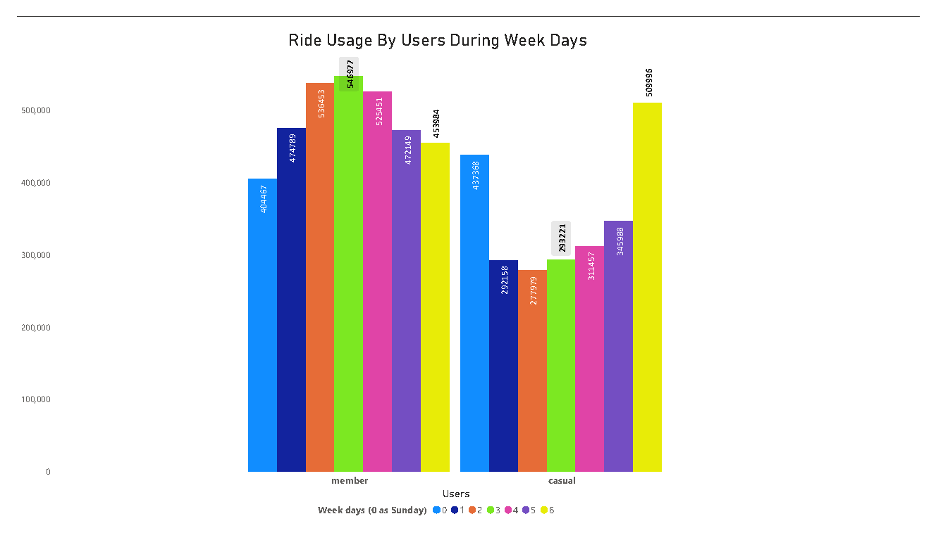
Cyclistic’s members use the bikes more often during the weekdays, with Wednesday as the peak day (546,977 users)
While Casual customers use Cyclistic’s bikes more often during the weekends most Saturdays (509,996 users)

Slide 9
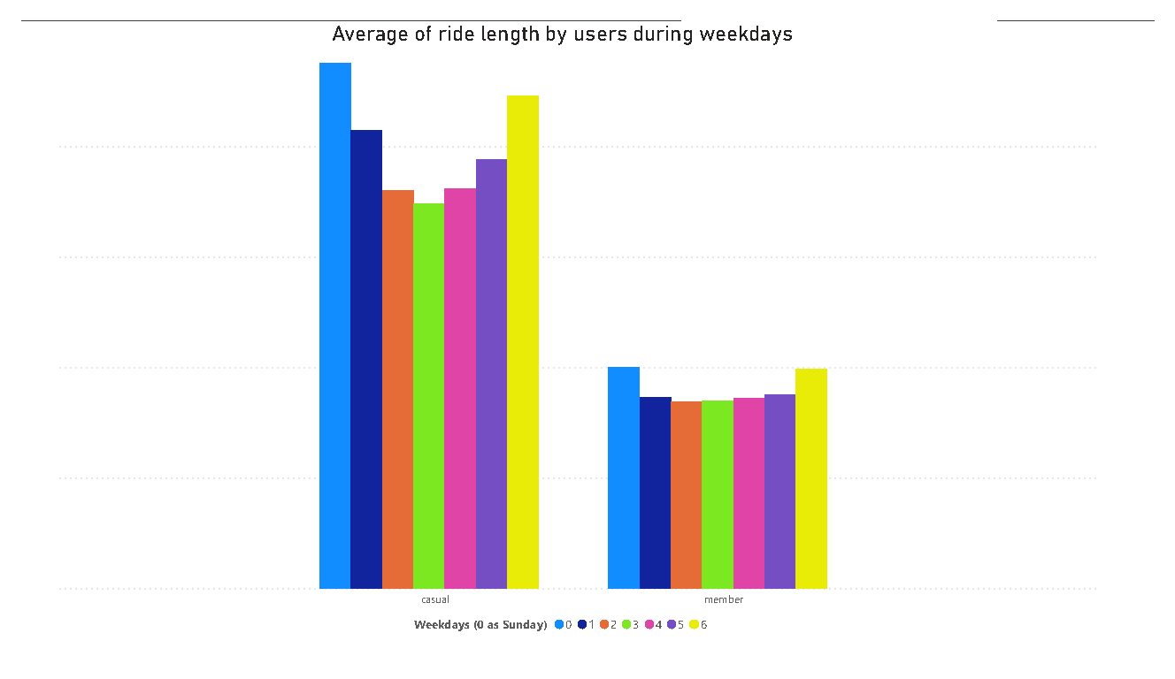
Casual customers have higher average ride length all through the weekdays than the members
Still, the peak average usage by Casual customers is the weekend: Saturday and Sunday
While the average ride length for the members is almost similar all the weekdays with a little peak on the weekends
00:34:11
00:32:03
00:25:03
00:14:26
00:14:18
00:12:11

Slide 10
Maximum Ride by Each Customer Group
The Casual customers have a higher maximum ride per use than the Members.
Casual:
Member:
28 days 06:25:01
1 day 01:59:54

Slide 11
Recommendations

Slide 12
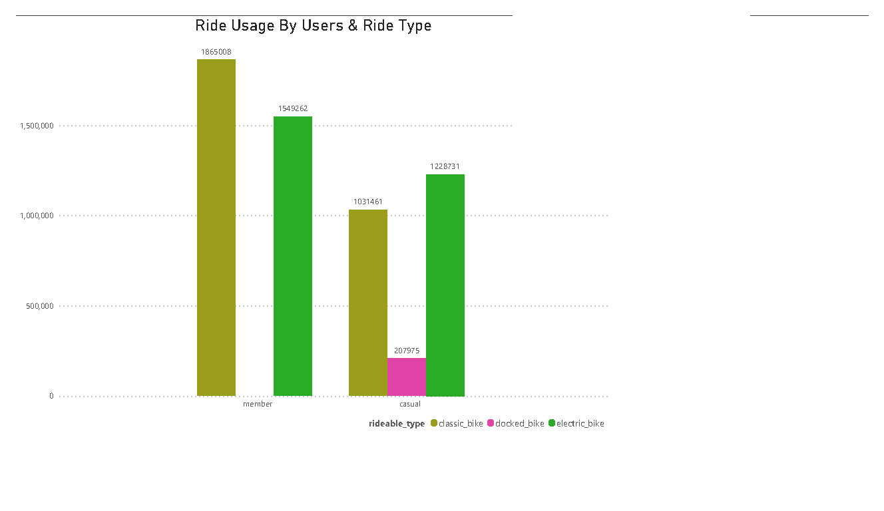
It will be profitable for Cyclistic to convert Casual customers to Members
Casual customers use more of electric and classic bikes during weekends: Saturdays and Sundays: thus all conversion efforts should be tailored the same way.

Slide 13
Addendum: SQL Queries for Data Analysis

Slide 14
-- Created the tables and copied the dataset from my downloaded CSV file: the query was repeated for the rest of the 11 months analysed.
CREATE TABLE tripdata_2021 (
ride_id varchar(20),
rideable_type varchar(20),
started_at timestamp,
ended_at timestamp,
start_station_name varchar(100),
start_station_id varchar(50),
end_station_name varchar(100),
end_station_id varchar(50),
start_lat double precision,
start_lng double precision,
end_lat double precision,
end_lng double precision,
member_casual varchar (6)
);
COPY tripdata_202111
FROM 'C:\Users\shimo\Desktop\New folder\GDA\Google Data Analytics\8 Capstone\Bicycle Sharing\Files Unzipped CSV\202111-divvy-tripdata.csv'
WITH (FORMAT CSV, HEADER);

Slide 15
--Created a new table using likeness of one of the existing tables and created its dataset by the union of all the entire 12 months
CREATE TABLE trip_data (LIKE tripdata_202109);
INSERT INTO trip_data
SELECT *
FROM tripdata_202109
UNION ALL
SELECT *
FROM tripdata_202110
UNION ALL
SELECT *
FROM tripdata_202111
UNION ALL
SELECT *
FROM tripdata_202112
UNION ALL
SELECT *
FROM tripdata_202201
UNION ALL
SELECT *
FROM tripdata_202202
UNION ALL
SELECT *
FROM tripdata_202203
UNION ALL
SELECT *
FROM tripdata_202204
UNION ALL
SELECT *
FROM tripdata_202205
UNION ALL
SELECT *
FROM tripdata_202206
UNION ALL
SELECT *
FROM tripdata_202207
UNION ALL
SELECT *
FROM tripdata_202208;
SELECT *
FROM trip_data;

Slide 16
--created a copy of my joined table
CREATE TABLE trip_data_copy (LIKE trip_data );
INSERT INTO trip_data_copy
SELECT *
FROM trip_data;
--removed unnecessary columns
ALTER TABLE trip_data
DROP COLUMN start_station_name,
DROP COLUMN start_station_id,
DROP COLUMN end_station_name,
DROP COLUMN end_station_id,
DROP COLUMN start_lat,
DROP COLUMN end_lat,
DROP COLUMN end_lng;
ALTER TABLE trip_data
DROP COLUMN start_lng;
--created index for easier querying
CREATE INDEX ended_at_idx ON trip_data (ended_at);
CREATE INDEX started_at_idx ON trip_data (started_at);
CREATE INDEX ride_length_idx ON trip_data (ride_length);
--Deleted where trip_data = 0
DELETE FROM trip_data
WHERE ended_at = started_at;
--Deleted where trip_data is negative
DELETE FROM trip_data
WHERE ended_at < started_at
RETURNING *;

Slide 17
-- Added new column for ride_length and updated the new column as the difference
--between start and end times
ALTER TABLE trip_data
ADD COLUMN ride_length interval;
UPDATE trip_data
SET ride_length = ended_at - started_at;
--created index for easier querying
CREATE INDEX ended_at_idx ON trip_data (ended_at);
CREATE INDEX started_at_idx ON trip_data (started_at);
CREATE INDEX ride_length_idx ON trip_data (ride_length);
--Found the difference between the start and end times of the ride
--discovered negative values in ride length which are bad data
SELECT ride_id,
rideable_type,
started_at,
ended_at,
CAST (ended_at - started_at AS interval) AS ride_length
FROM all_combined_ridedata
ORDER BY ride_length;
--Deleted where trip_data = 0
DELETE FROM trip_data
WHERE ended_at = started_at;
--Deleted where trip_data is negative
DELETE FROM trip_data
WHERE ended_at < started_at
RETURNING *;

Slide 18
--Create new column week_day to calculate the week day each ride started
--From week_day column, 0 = sunday, 1 = monday, etc.
ALTER TABLE trip_data
ADD COLUMN week_day integer;
UPDATE trip_data
SET week_day = EXTRACT (DOW FROM started_at
);
-- Found the overall mean, max, mode and count of the ride length
SELECT
AVG (ride_length) AS total_mean_ridelength,
MAX (ride_length) AS max_ridelength,
MODE () WITHIN GROUP (ORDER BY ride_length) AS mode_of_ridelength,
COUNT (ride_length) AS total_ridelength_count
FROM trip_data;
--Calculating the mean, max, and count for the ridelength and mode by week day
--week day goes from 0 as Sunday to 6 as Saturday
SELECT
member_casual,
AVG (ride_length) AS total_mean_ridelength,
MAX (ride_length) AS max_ridelength,
MODE () WITHIN GROUP (ORDER BY week_day) AS mode_of_week_day,
COUNT (ride_length) AS total_ridelength_count
FROM trip_data
GROUP BY member_casual;
--Calculating the mean, max, and count for the ridelength and week day
--week day goes from 0 as Sunday to 6 as Saturday
SELECT
member_casual,
week_day,
AVG (ride_length) AS mean_ridelength_day,
COUNT (ride_length) AS ridelength_count_by_day
FROM trip_data
GROUP BY member_casual,
week_day;

Slide 19
--Calculating the mean, max, and count for the ridelength and ride type
--Confirming the ride type most used by the casual members
--to advise on the ride type to be adverised most
SELECT
member_casual,
rideable_type,
AVG (ride_length) AS mean_ridelength_day,
COUNT (ride_length) AS ridelength_count_by_day
FROM trip_data
GROUP BY member_casual,
rideable_type;

